Slide 1
EC2 Auto Scaling
Up and Down, Round and Round

Slide 2
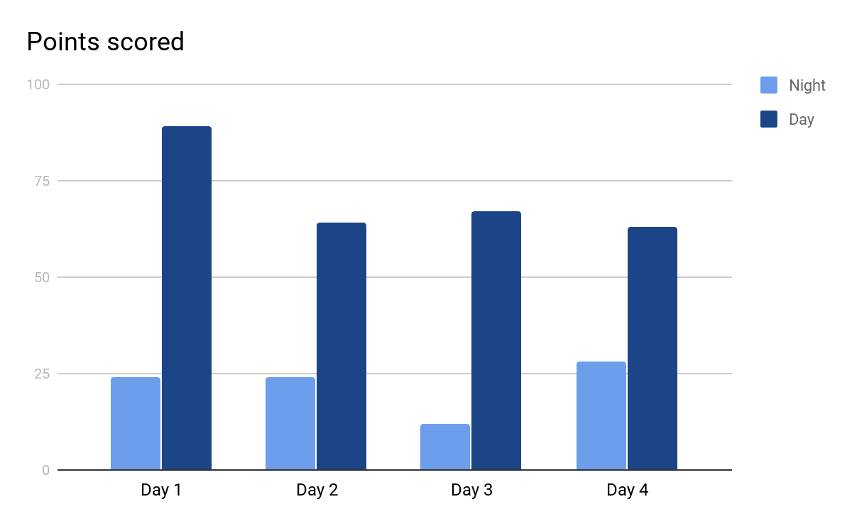
Understanding Scalability
.
Scalability is the ability of a system to change in size depending on the needs.
Infrastructure should scale to support changing in traffic patterns.
knowledge portal

Slide 3
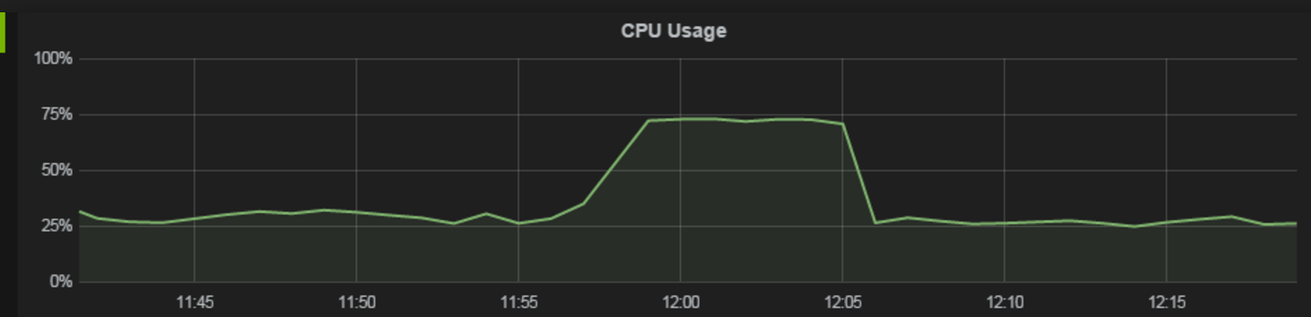
Launch and Remove Servers Based on Load
What if new servers automatically get launched on high load?
Simple Scaling Policy:
Base: 2 servers
Scalable :
If average CPU utilization > 60% ; add two more instance
If average CPU utilization < 30% ; remove two instance
knowledge portal

Slide 4
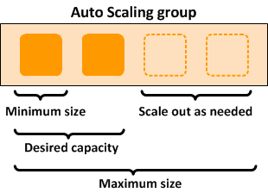
Overview of EC2 Auto-Scaling
Amazon EC2 Auto Scaling helps you maintain application availability and allows you to automatically add or remove EC2 instances according to conditions you define.
Example Scenario:
Minimum: 2 EC2 instance
Maximum: 10 EC2 instance
Threshold: 50% of CPU

Slide 5
Multiple Types of Scaling
Type of Scaling | Description
Scheduled Scaling | Servers are scaled based on a specific schedule. For example, every week the traffic to your web application starts to increase on Wednesday, remains high on Thursday, and starts to decrease on Friday
Dynamic Scaling | Follow the demand curve for scaling activities. CPU Utilization higher then 90%
Predictive Scaling | Predictive Scaling has machine learning algorithms that detect changes in daily and weekly patterns, automatically adjusting their forecasts.
knowledge portal

Slide 6
Implementing Auto Scaling
Practical Part

Slide 7
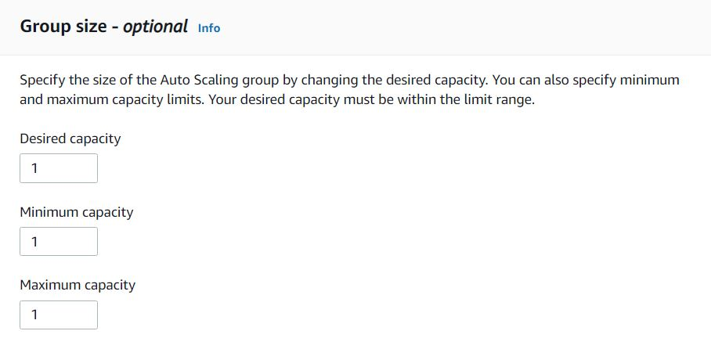
Auto-Scaling Concepts
While configuring auto-scaling, you set the minimum, maximum and desired capacity.
knowledge portal

Slide 8

Auto-Scaling Concepts - Minimum Capacity
Minimum | 1
Maximum | 5
knowledge portal

Slide 9
Auto-Scaling Concepts - Maximum Capacity
Minimum | 1
Maximum | 5
knowledge portal

Slide 10
Auto-Scaling Concepts - Desired Capacity
Minimum | 1
Desired | 2
Maximum | 5
knowledge portal

Slide 11
Auto Scaling Group Size
Minimum denotes minimum number of EC2 instances that will run.
Maximum denotes maximum number of EC2 instances that can be scaled.
Desired capacity denotes the number of Amazon EC2 instances that should be running in the group.
knowledge portal

Slide 12
Launch [Configuration/Template]
Contains instance configuration information, some of these include:
AMI ID
Security Groups
Instance Types
Key Pair
It is recommended to use Launch Template instead of Launch configuration.
knowledge portal

Slide 13
Health Checks
Amazon EC2 Auto Scaling can determine the health status of an instance using one or more of the following:
Health Check | Description
EC2 | Provided by Amazon EC2 to identify hardware and software issues that may impair an instance. If the instance is in any state other than running or if the system status is impaired
ELB | Health checks provided by Elastic Load Balancing (ELB). These health checks are disabled by default but can be enabled.
knowledge portal

Slide 14
2 Types of Scaling
There are two major types of scaling types that are available:
Scaling Types
Manual Scaling
Dynamic Scaling
knowledge portal

Slide 15
Manual Scaling
Manual scaling is the most basic way to scale your resources, where you specify only the change in the maximum, minimum, or desired capacity of your Auto Scaling group.
Amazon EC2 Auto Scaling manages the process of creating or terminating instances to maintain the updated capacity.
knowledge portal

Slide 16
Dynamic Scaling
When you configure dynamic scaling, you define how to scale the capacity of your Auto Scaling group in response to changing demand.
Scaling Policy Types | Descriptions
Target tracking scaling | Increase or decrease the current capacity of the group based on a target value for a specific metric.
Step scaling | Increase or decrease the current capacity of the group based on a set of scaling adjustments, known as step adjustments, that vary based on the size of the alarm breach.
Simple scaling | Increase or decrease the current capacity of the group based on a single scaling adjustment.

Slide 17
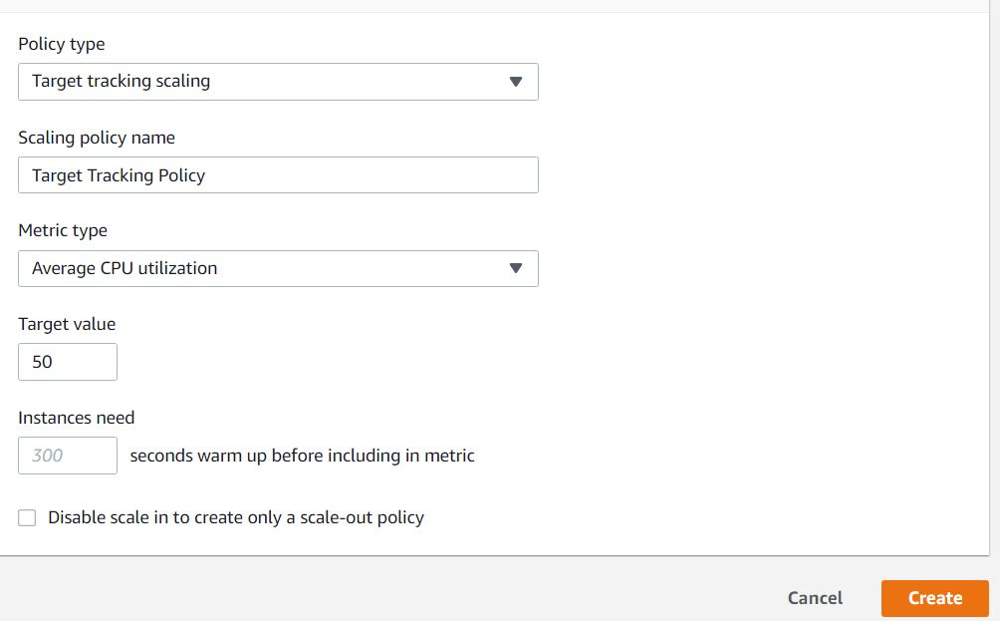
Target Tracking Policy
With target tracking scaling policies, you select a scaling metric and set a target value.
The scaling policy adds or removes capacity as required to keep the metric at, or close to, the specified target value.
knowledge portal

Slide 18
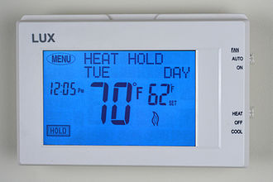
Use Case of Thermostat
A thermostat is a component which senses the temperature of a physical system and performs actions so that the system's temperature is maintained near a desired setpoint.
Example:
Desired = 24
Current = 18
knowledge portal

Slide 19
Example Target Tracking Policy
Metric Type = CPU Utilization
Target Value = 50%
50% CPU
50% CPU
knowledge portal

Slide 20
Example Target Tracking Policy
Metric Type = CPU Utilization
Target Value = 50%
Actual Value = 70%
70% CPU
70% CPU
knowledge portal

Slide 21
Example Target Tracking Policy
Metric Type = CPU Utilization
Target Value = 50%
50% CPU
50% CPU
40% CPU
knowledge portal

Slide 22
Example Target Tracking Policy
Metric Type = CPU Utilization
Target Value = 50%
Actual Value = 15%
15% CPU
15% CPU
15% CPU
knowledge portal

Slide 23
Example Target Tracking Policy
Metric Type = CPU Utilization
Target Value = 50%
Actual Value = 45% (combined)
45% CPU
15% CPU
15% CPU
knowledge portal

Slide 24
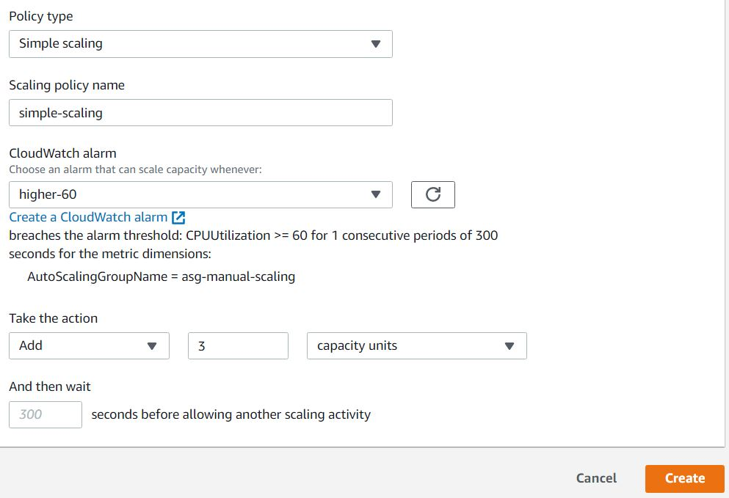
Simple Scaling Policy
With simple scaling policy, you can configure a specific number of instances to be added when a threshold reaches certain value.
knowledge portal

Slide 25
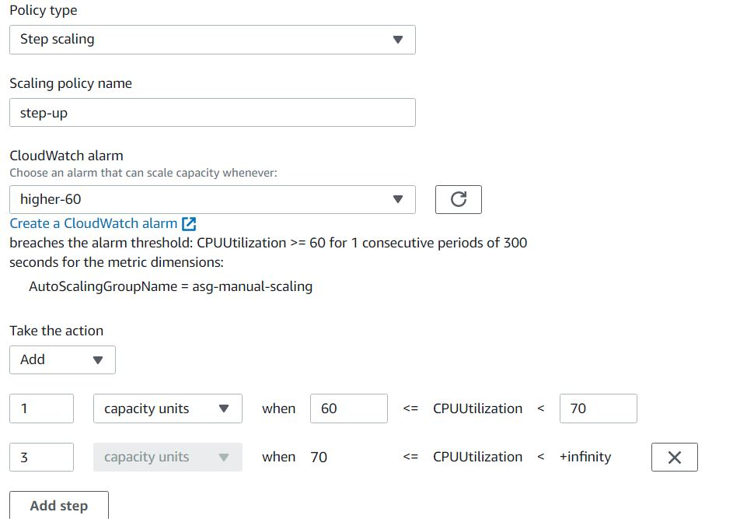
Step Scaling Policy
In step scaling, the adjustment of the current capacity of instances vary based on the size of the alarm breach.
knowledge portal

Slide 26
Dynamic Scaling
Overview

Slide 27
2 Types of Scaling
There are two primary types of scaling approaches that are available:
Scaling Types
Manual Scaling
Dynamic Scaling
knowledge portal

Slide 28
Dynamic Scaling
When you configure dynamic scaling, you define how to scale the capacity of your Auto Scaling group in response to changing demand.
Scaling Policy Types | Descriptions
Target tracking scaling | Increase or decrease the current capacity of the group based on a target value for a specific metric.
Step scaling | Increase or decrease the current capacity of the group based on a set of scaling adjustments, known as step adjustments, that vary based on the size of the alarm breach.
Simple scaling | Increase or decrease the current capacity of the group based on a single scaling adjustment.

Slide 29
Simple Scaling Policy
With simple scaling policy, you can configure a specific number of instances to be added when a threshold reaches certain value.
knowledge portal

Slide 30
Step Scaling Policy
In step scaling, the adjustment of the current capacity of instances vary based on the size of the alarm breach.
knowledge portal

Slide 31
Target Tracking Policy
With target tracking scaling policies, you select a scaling metric and set a target value.
The scaling policy adds or removes capacity as required to keep the metric at, or close to, the specified target value.
knowledge portal

Slide 32
Use Case of Thermostat
A thermostat is a component which senses the temperature of a physical system and performs actions so that the system's temperature is maintained near a desired setpoint.
Example:
Desired = 24
Current = 18
knowledge portal

Slide 33
Example Target Tracking Policy
Metric Type = CPU Utilization
Target Value = 50%
50% CPU
50% CPU
knowledge portal

Slide 34
Example Target Tracking Policy
Metric Type = CPU Utilization
Target Value = 50%
Actual Value = 70%
70% CPU
70% CPU
knowledge portal

Slide 35
Example Target Tracking Policy
Metric Type = CPU Utilization
Target Value = 50%
50% CPU
50% CPU
40% CPU
knowledge portal

Slide 36
Example Target Tracking Policy
Metric Type = CPU Utilization
Target Value = 50%
Actual Value = 15%
15% CPU
15% CPU
15% CPU
knowledge portal

Slide 37
Example Target Tracking Policy
Metric Type = CPU Utilization
Target Value = 50%
Actual Value = 45% (average)
45% CPU
15% CPU
15% CPU
knowledge portal

Slide 38
Scheduled Scaling
Overview and Practical

Slide 39
Overview of Scheduled Scaling
Scheduled scaling allows you to set your own scaling schedule.
For example, let's say that every week the traffic to your web application starts to increase on Wednesday, remains high on Thursday, and starts to decrease on Friday.
Scaling actions are performed automatically as a function of time and date.
knowledge portal

Slide 40
Global Accelerator
Understanding The Basics

Slide 41


Overview of Global Accelerator
AWS Global Accelerator is a service that improves the availability and performance of your applications with local or global users.
It provides static IP addresses that act as a fixed entry point to your application endpoints in a single or multiple AWS Region
Singapore
Global Accelerator
User from India
North Virginia
User from Canada

Slide 42
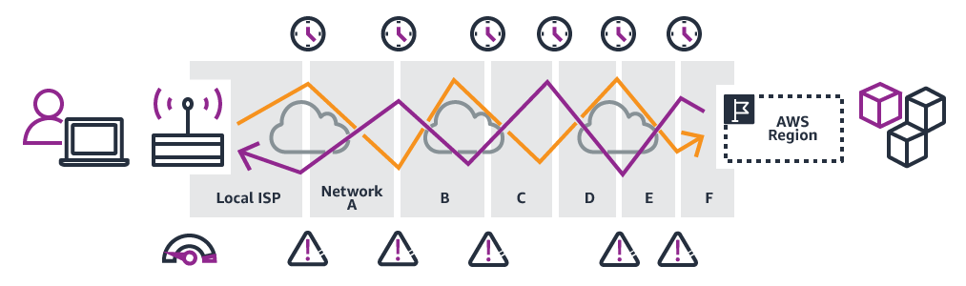
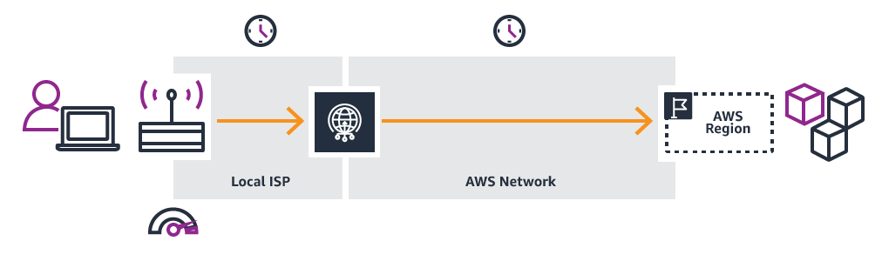
Simplified Diagrammatic Difference
Without
Global Accelerator
After
Global Accelerator

Slide 43
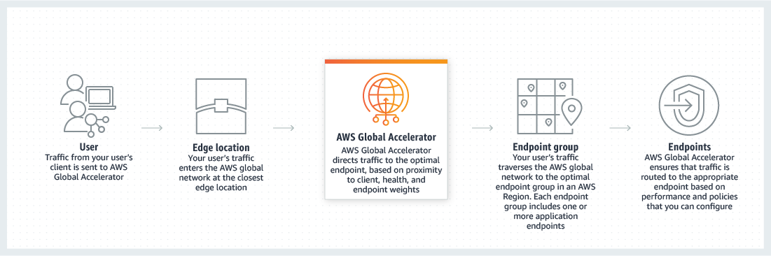
Working of Global Accelerator

Slide 44
Elastic Beanstalk
Orchestration

Slide 45








Traditional Deployment Approach
Use-Case: Deploy a simple Hello World application for production.
Resources to be created: AWS EC2, ELB, Auto-Scaling, Web-Server Configuration, and others.
DNS
Logs
EC2
ASG
Client
ELB
EC2 Resource
CloudWatch
knowledge portal

Slide 46
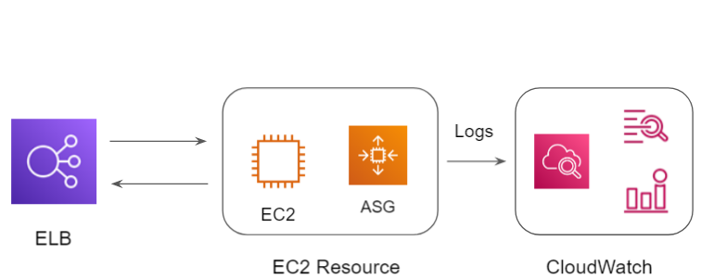

Elastic Beanstalk Deployment Approach
Use-Case: Deploy a simple Hello World application for production.
Create Elastic Beanstalk Environment
Elastic Beanstalk
knowledge portal

Slide 47
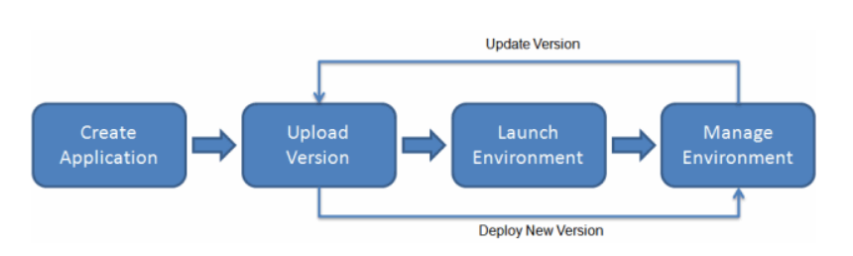
Overview of Elastic Beanstalk
AWS Elastic Beanstalk is an easy-to-use service for deploying and scaling web applications and services.
You can simply upload your code and Elastic Beanstalk automatically handles the deployment, from capacity provisioning, load balancing, auto-scaling to application health monitoring.
knowledge portal

